Slide 1
Lecture 2
Nick Rugai PhD

Slide 2
What is an Algorithm?

Slide 3
What is an Algorithm?
An Input
An Output
A set of finite Operations
Typically to solve for a Problem

Slide 4
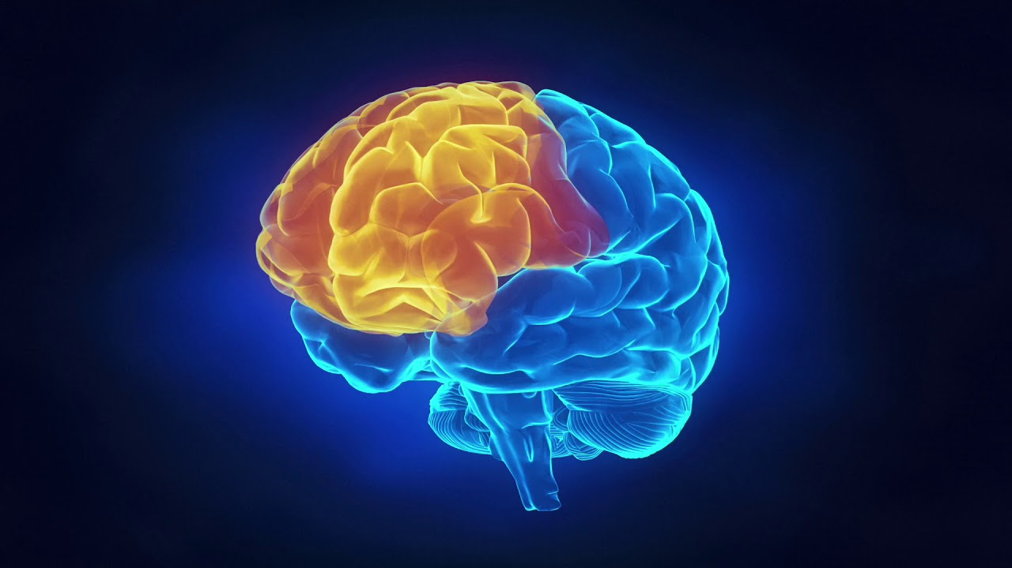
What is an Algorithm?
The Mind is a complex algorithm that runs on the Brain.

Slide 5
Computing Language
Natural languages, like English, they were not designed, they evolved over time.
Formal Languages were designed:
Mathematics, Logic, Chemical Formulas, etc.
Computing Languages are Formal Languages.
Formal Languages have very strict syntax.
Formal Languages lack: Ambiguity, Redundancy, Metaphors, Analogies, Poetry, Prose, Sarcasm!
Formal languages need to be Parsed.
Parsing allows to decipher the language.

Slide 6

PYTHON

Slide 7

PYTHON

Slide 8
PYTHON
Created and Released in 1991 by Guido Van Rossum
Ease of readability
Lax syntax
Object Oriented:
Re-usability of ‘Objects’ such as functions, methods, variables, etc.
Extensive use of Libraries.

Slide 9
PYTHON
Interpreted
Vs. Complied
High-Level (abstraction)
Vs. Low-Level (no abstraction)
8B542408 83FA0077 06B80000 0000C383
FA027706 B8010000 00C353BB 01000000
B9010000 008D0419 83FA0376 078BD989
C14AEBF1 5BC3
General Purpose Computing Language
Variety of Software Applications

Slide 10
THE ZEN OF PYTHON
Beautiful is better than ugly.
Explicit is better than implicit.
Simple is better than complex.
Complex is better than complicated.
Readability counts.

Slide 11
PYTHON
Open the Python Shell
The Prompt: >>>>
>>>> 1+1
>>>> 8*8
>>>>64/2
First Program:
>>>> print (‘Hello Universe!’)
>>>> print (“Hello Universe!”)
>>>> print (‘”Hello Universe!”’)
print is a Function, ‘Hello Universe’ is a Value
print is an algorithm: print(x): x is the value input, the printed token is the output, the logic needed to print it out is the finite set of instruction.

Slide 12
Values & Types
>>>>type(2)
>>>>type(2.2)
>>>>type(‘Universe’)
>>>>type (‘2.2’)
>>>help(int)
Ctrl C

Slide 13
Debugging
Program mistakes are called Bugs.
The process of finding and fixing the bugs goes by Debugging.
Debugging is the source of all evil:
Anger
Frustration
Lack of Sleep
Rage
Embarrassment
Disappointment
Violence

Slide 14
Debugging
But these are human emotions!
Computers do not think that way!
You must think like a computer, you must be emotionless, calculated, cold.
You must become a machine!

Slide 15
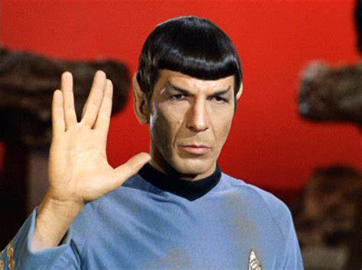
Become a Machine!

